Slide 1
The Sixth Meeting of the Scientific and Technical Advisory Committee (STAC) of the Protocol Concerning Pollution from Land-Based Sources and Activities in the Wider Caribbean
Presenter: Christopher Corbin
Coordinator, Cartagena Convention Secretariat Christopher.Corbin@un.org
Photo credit: Plastic Generation.com

Slide 2
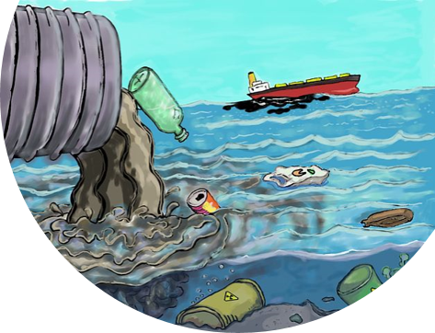
The Protocol Concerning Pollution from Land-Based Sources and Activities (LBS Protocol)
Objectives of the LBS Protocol:
Reduce pollution by setting emission and effluent limitations and/or through best management practices Exchange information on land-based pollution through cooperation in monitoring and investigation.
Obligations:
Classify recreational water bodies based on pollution risk to human health & the environment
Establish legally binding standards for sewage effluent & discharges
Develop National Programmes of Action for Integrated Watershed and Coastal Area Management
Identify & assess sources & activities contributing to pollution
Develop management plans & demonstration projects to reduce marine pollution

Slide 3
Thematic Approach: Summary of Activities
Programme Coordination & Management
Ecosystem-Based Management Approaches
Land & Marine- Based Sources of Pollution
Knowledge Management & Communications
Monitoring & Integrated Ecosystem Assessment

Slide 4
A. Programme Coordination and Management

Slide 5
Implementation through Partnerships
RACs & RANs
Synergies with Global Decades, MEAs, UNEP Global Programme of Action, Regional Seas & UNEP Regional & Sub- Regional Offices
RACs
Regional Activity Network
Central American Commission for Environment and Development
Water Centre for the Humid Tropics of Latin America and the Caribbean
Institute of Marine and Coastal Research
Caribbean and Central America
University of Para

Slide 6
Programme Coordination and Management
New cooperation agreements signed with partners, e.g., LBS RACs, OSPAR
Discussions with International Atomic Energy Agency/INVEMAR and promoting greater cooperation among environmental laboratories – Regional Activity Network
REGIONAL COORDINATION, COLLABORATION & SYNERGIES
SUPPORT FOR RATIFICATION OF THE LBS PROTOCOL
Workshops for Non-Contracting Parties – Needs Assessment
Technical guidance provided to Suriname, Saint Kitts-Nevis and St. Vincent and the Grenadines
Decisions of Project Steering Committees
Nutrient management, Integrated Water and Wastewater Management, plastics and marine litter (Integration with MPAs grants under SPAW)
GEF IWEco, GEF CReW+, ACP MEAs III, Sida Grant, GPNM and Norway to provide financial support.
TECHNICAL SUPPORT TO IMPLEMENT THE OIL SPILLS & LBS PROTOCOLS
GEF International Waters (IW):
GEF Gulf of Mexico Large Marine Ecosystem (GoM LME) Project
GEF IW: LEARN 5
GEF 8 Pipeline
GEF LAC Cities: Pan, Col & Jam
ProCaribe: Regional
PROMAR: BVI, TnT, Guy, Sur & SKN
PROJECT DEVELOPMENT & APPROVAL
Notes:
Regional Coordination: Further to MOUs signed during the previous biennium with agencies that now form part of the Regional Activity Network (RAN) for the LBS Protocol, cooperation was enhanced through Small Scale Funding Agreements (SSFAs) and participation at conferences
Ratification: Workshop for Non-Contracting Parties held. Needs identified. Funding identified under CReW+ and ACP MEA. Activities included in SSFAs with RAC CIMAB and RAC IMA.

Slide 7
Programme Coordination and Management
(cont’d)
SUPPORT TO THE OPEN-ENDED WORKING GROUP
Virtual meetings convened, thematic sub-groups established, experts nominated, and officers elected.
Geographical Information Systems (GIS) to address oil spill pollution, preparedness and response
Behaviour change workshop planned to control, reduce and prevent marine pollution from domestic wastewater (TNC)
Wastewater Management – GEF CReW+ Academy
Monitoring of Water Quality
CAPACITY BUILDING INITIATIVES
The Global Partnership on Nutrient Management (GPNM)
The Swedish International Development Cooperation Agency (SIDA) grant (UNEP Headquarters)
Swedish Ministry of Environment
ACP MEAs III Project
GEF CReW+ Project
Government of Germany
RESOURCE MOBILIZATION
Committee for Regional Strategic Action Plan on Water Resources Management (RSAP)
Global Water Partnership Caribbean Technical Committee
BASEL Convention Plastics Working Group
Regional Committee on Solid Waste
Ocean Sewage Alliance and other Regional and Global Intiatives
STRATEGIC COMMITTEES
Notes:
Building Initiatives: Capacity Partnerships developed with the Ocean Sewage Alliance (OSA), The Nature Conservancy (TNC) and RARE to develop joint capacity-building activities on behaviour change relating to the control, reduction and prevention of marine pollution from domestic wastewater.

Slide 8
Resource Mobilization (USD)
The Global Partnership on Nutrient Management (GPNM) | $ 45,000
SIDA Grant (UNEP Regional Seas) | $105,000
ACP MEAs III Project | $409,607*
GEF CReW+ Project | $3,844,780.76**
*Includes components focused on LBS, overall governance and communications. ** To support the implementation of national projects and consultancies for GEF CReW+ beneficiary countries. The project also provided co-financed technical support for unfunded Secretariat activities.

Slide 9
Intergovernmental, technical/expert and other meetings convened by the AMEP Sub-Programme, LBS RACs and GEF Projects (2021-2022)
Programme Area | Title | Venue | Date
AMEP/CEP | 5th Meeting of the Contracting Parties (COP) to the Protocol Concerning Pollution from Land-Based Sources and Activities (LBS) in the Wider Caribbean Region | Virtual | 26 July 2021
AMEP/SPAW/CEP | 19th Intergovernmental Meeting on the Action Plan for the Caribbean Environment Programme and 16th Meeting of the Contracting Parties to the Convention for the Protection and Development of the Marine Environment of the Wider Caribbean Region | Virtual | July 2021
GEF CReW+ | GEF CReW+ 2nd Project Steering Committee Meeting | Virtual | 27-28 April 2022
AMEP/Oil Spills Protocol | The Tenth Ordinary Steering Committee Meeting of the Regional Marine Pollution Emergency, Information and Training Centre – Caribe (RAC REMPEITC-Caribe) | Willemstad, Curacao | 18-19 May 2022
GEF IWEco | GEF IWEco's 6th Regional Project Steering Committee Meeting | Port of Spain, Trinidad and Tobago | 18-20 July 2022
AMEP in collaboration with the LBS RACs/SPAW RAC/INVEMAR | Regional Workshop on the Index of Coastal Eutrophication and Harmful Algal Blooms | Chaguaramas , Trinidad and Tobago | 25-27 July 2022
EU ACP MEAs III | ACP MEAs III 3rd Project Steering Committee Meeting | Brussels, Belgium | 19-20 October 2022
AMEP | Regional Eutrophication Workshop | Hybrid | 13-14 December 2022
AMEP | GEF LAC Cities Pre-Inception Workshop | Virtual | 16 January 2023

Slide 10
B. Land & Marine-Based Sources of Pollution

Slide 11
LBS: Oil Spills, Marine Litter & Nutrients
Providing technical support to parties to assess, prepare and adopt national contingency plans (Barbados)
Regional Marine Pollution Emergency, Information and Training Centre- Caribe
Integrate early warning systems on Oil spills and sargassum led by IMA, through COSTA Program and NOAA
Drafts regulations for the International Convention for the Prevention of Pollution from Ships (MARPOL), (Dominican Republic)
Marine Litter/Plastic Reduction Strategy and Action Plan for Saint Lucia with co-financing from UNEP Science Division.
Provided technical input to the development of National Marine Litter Action Plan for Belize
Support to implementation of the Regional Nutrients Pollution Reduction Strategy – Case Studies developed for Jamaica and Barbados
ACP MEAs III Project

Slide 12
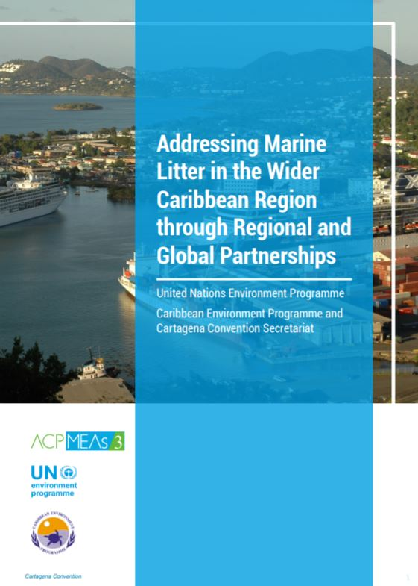
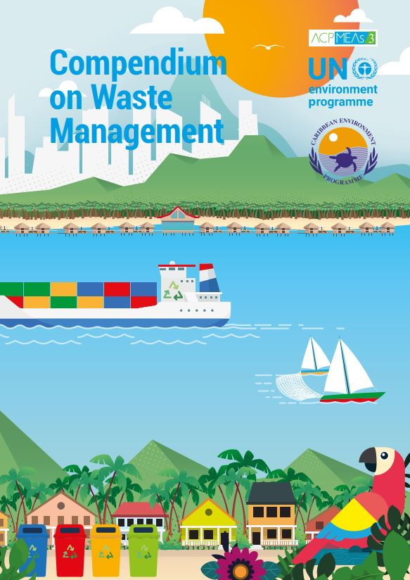
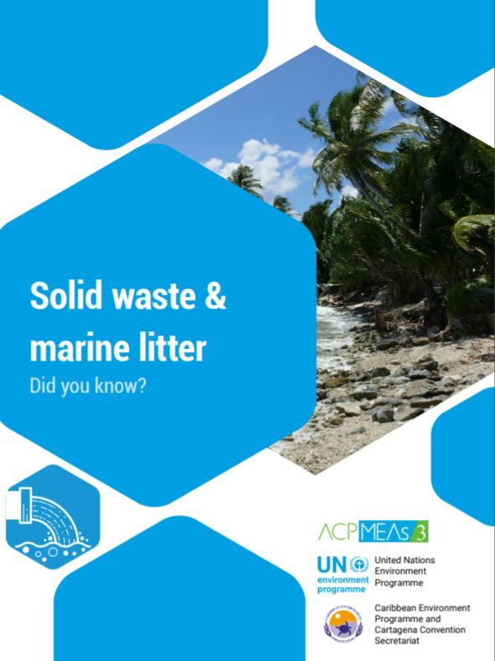
Marine Litter Publications

Slide 13
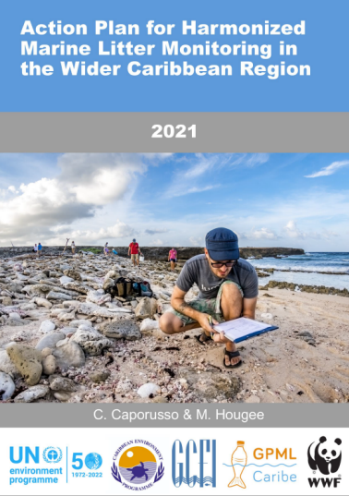
Global Partnership on Marine Litter
Gulf and Caribbean Fisheries Institute – co-host of Caribbean Regional Node (GPML-Caribe)
Support for UN Volunteer at the Secretariat
Technical sessions on marine litter through the Caribbean Node (7IMDC)
Marine litter prevention small grants programme (ACP MEA III)
US$108,595 awarded
3 marine litter
3 hybrid community-based projects on plastic reduction, reuse, and recycling
Global Ghost Gear Initiative pilot in Small Island Developing States - GCFI
Support to update the Caribbean Waste Management Plan (CWMAP) and Central America Regional Marine Litter Plan – close collaboration with Regional Office in Panama
Notes:
In September 2022, the Gulf and Caribbean Fisheries Institute (GCFI) in collaboration with the Secretariat, co-hosted a technical session titled ‘Fostering Partnerships to Address Marine Litter in the Wider Caribbean’ during the 7IMDC
GPML-Caribe supported the update and ongoing implementation of the Caribbean Waste Management Action Plan: Priorities and Plans Report (CWMAP), which complements the Caribbean Regional MarineLitter Strategy and Action Plan.
Funded by the ACP MEAs III project, GCFI small grant programme supported organizations in the management of marine litter and capacity-building at site-specific marine protected areas (MPAs) in WCR.

Slide 14
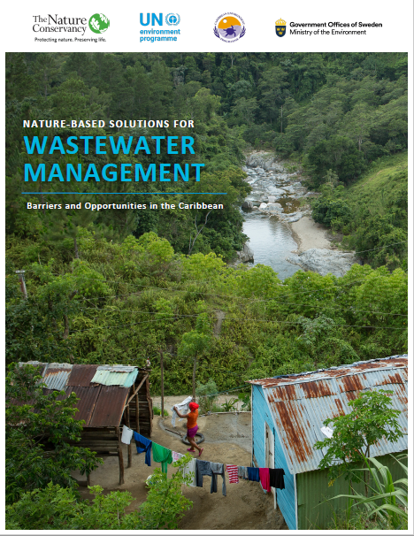
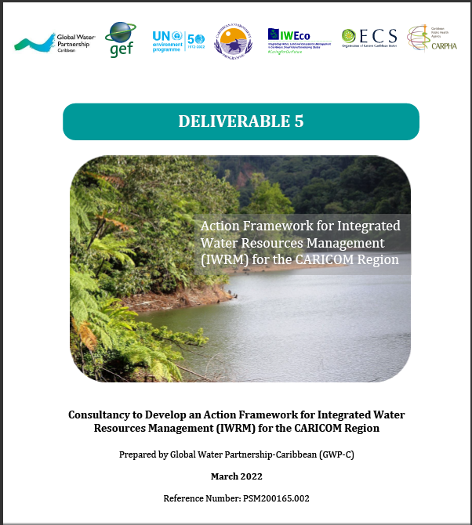
Publications

Slide 15
C. Monitoring & Integrated Ecosystem Assessment

Slide 16
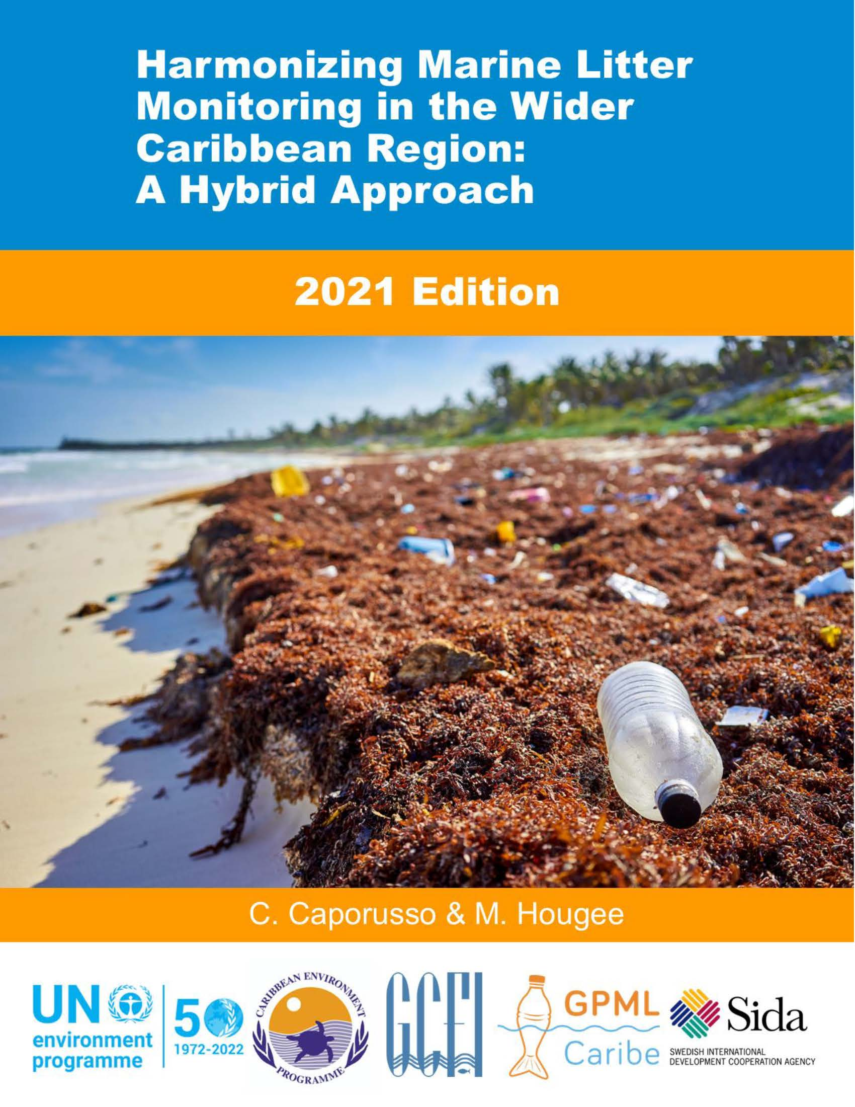
Monitoring systems and capacity
Regional Environmental Monitoring Data Portal (REMDAP) under development for GEF IWEco countries.
National Water Information Management Systems (WIMS) under development for 6 GEF CReW+ countries.
Regional environmental monitoring platform developed with support of University of Geneva
Technical capacity-building sessions convened, e.g., laboratory training, Microplastics, Index of Coastal Eutrophication, and nutrients workshop
Partners – Association of Caribbean States, LBS Regional Activity Centres (RACs), INVEMAR, Barcelona Convention, Plan Bleu (RAC for Information)
Collaboration with the Science Division – Global Environment Monitoring Systems (GEMS Oceans and Freshwater) linking to World Environment Situation Room
Notes:
GPML-Caribe supported the update and ongoing implementation of the Caribbean Waste Management Action Plan: Priorities and Plans Report (CWMAP), which complements the Caribbean Regional MarineLitter Strategy and Action Plan.

Slide 17
D. Ecosystem-Based Management

Slide 18
Hello rain - Rainwater harvesting
Developed through UN Human Security Trust Fund Project for Jamaica

Slide 19
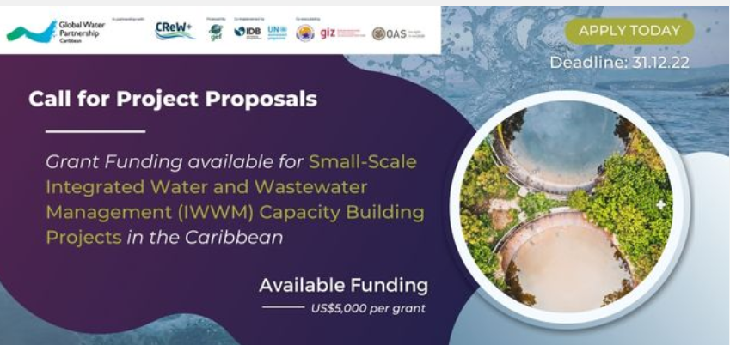
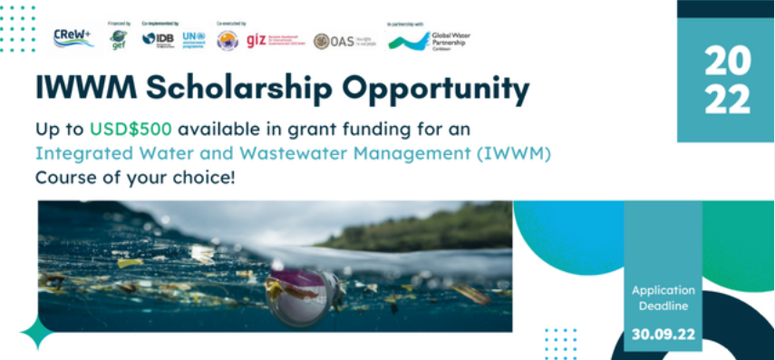
EBM Initiatives
Conclusion of EBM projects in Guyana, Suriname and Trinidad and Tobago – Video and Case Study
Ongoing Implementation of National Projects under GEF IWEco (10 countries) and GEF CReW+ (18 countries)
Enabling Training activities on Integrated Water and Wastewater Management e.g. Media, Youth (GEF CReW+)
Call for small grants proposals and scholarships by Global Water Partnership Caribbean – GWP C (GEF CReW+)
Training and pilot projects through the Caribbean Association of Water Utilities – CAWASA and the Caribbean Water and Wastewater Association
Notes:
GPML-Caribe supported the update and ongoing implementation of the Caribbean Waste Management Action Plan: Priorities and Plans Report (CWMAP), which complements the Caribbean Regional MarineLitter Strategy and Action Plan.

Slide 20
E. KNOWLEDGE MANAGEMENT

Slide 21
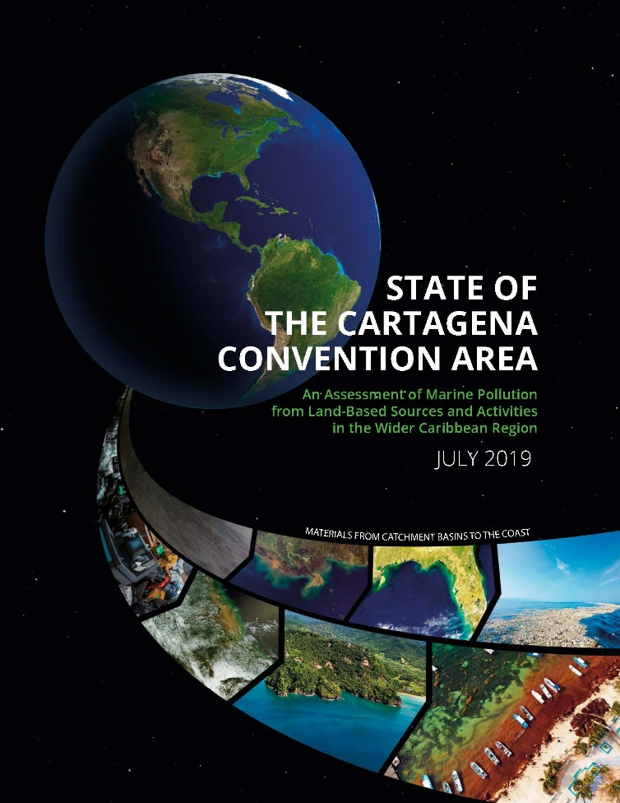
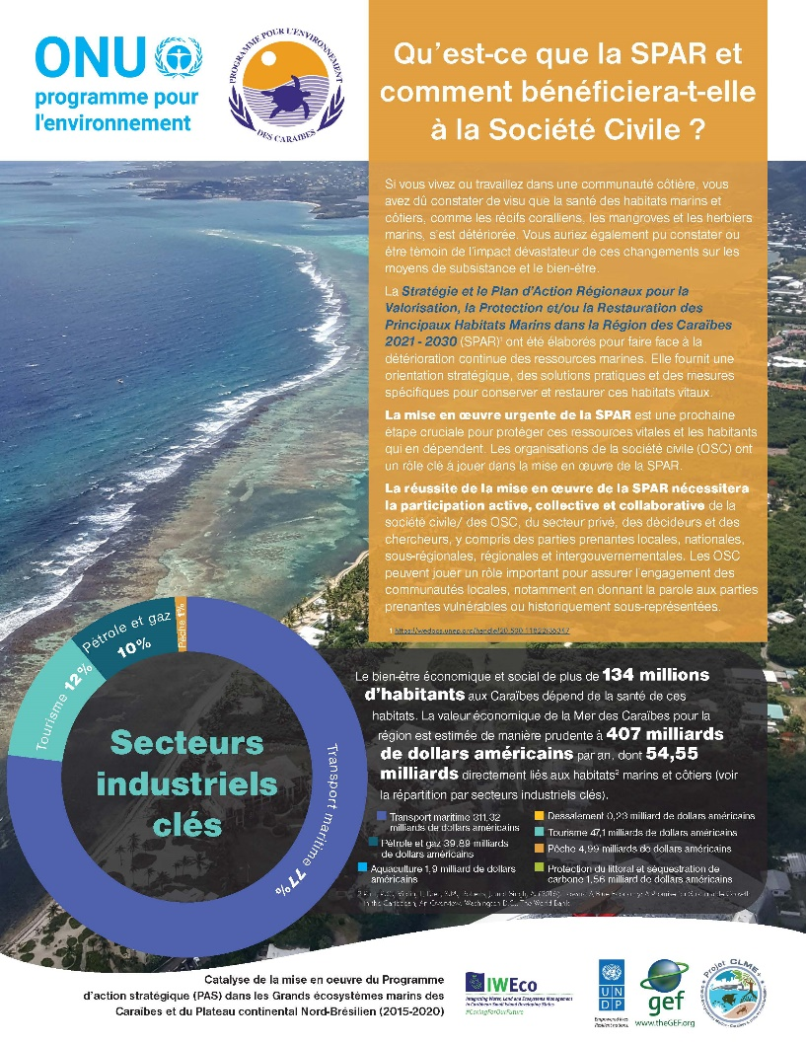
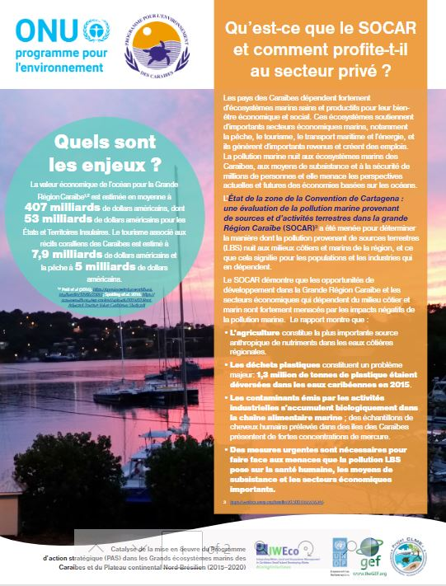
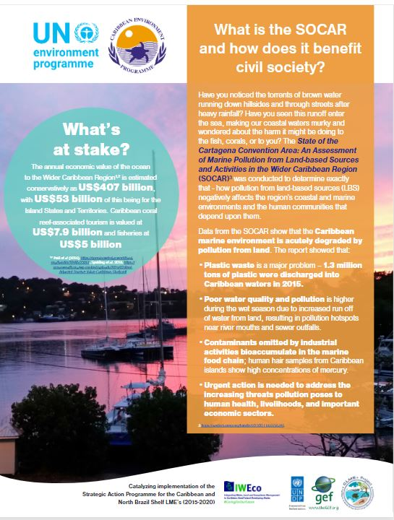
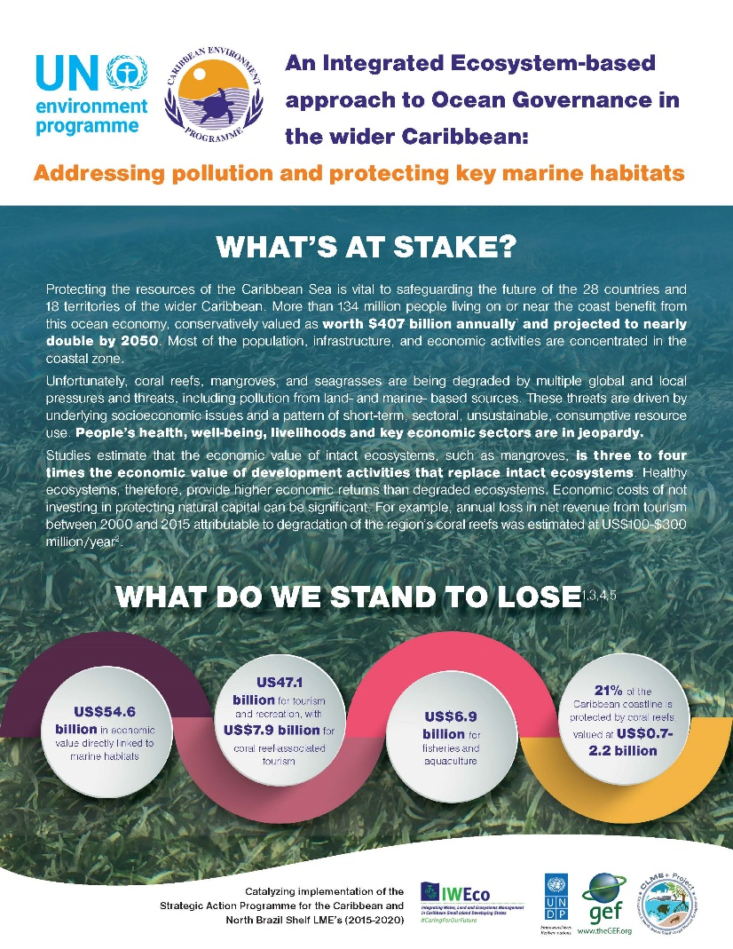
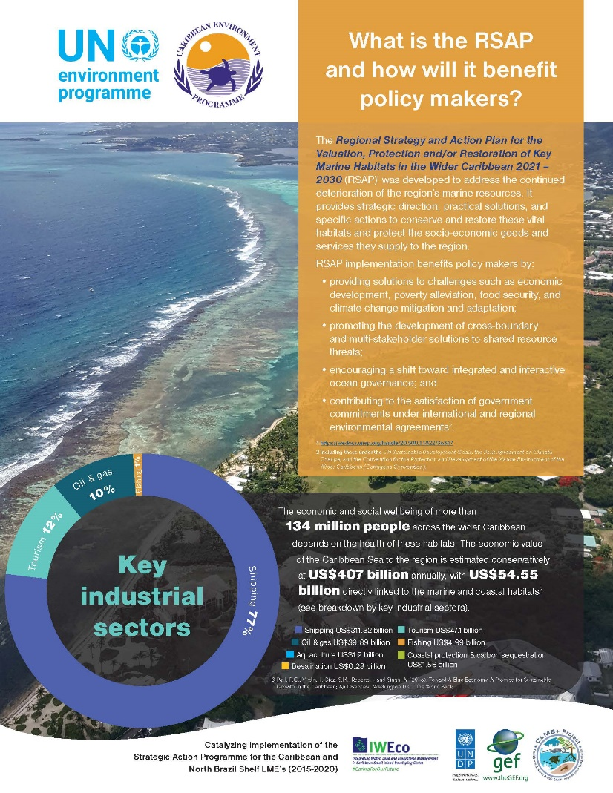
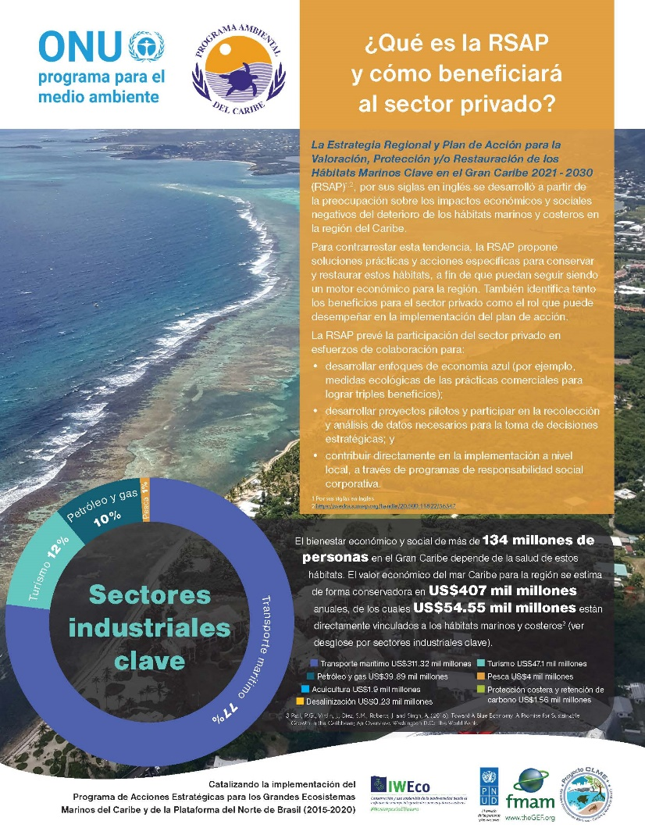
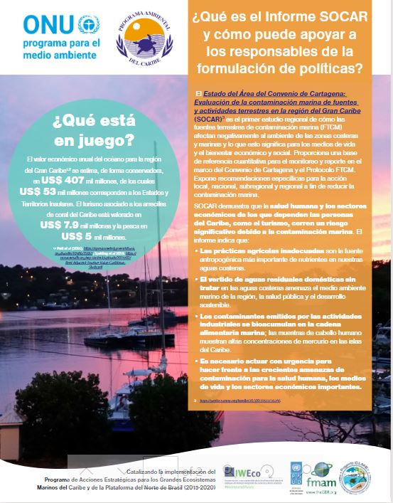
State of Convention Area Report on Marine Pollution (SOCAR), Regional Nutrients Pollution Reduction Strategy - Synergies with the State of Habitat Reports & RSAP
Summaries developed by CANARI in English, Spanish & French
To download, visit: https://www.unep.org/cep/

Slide 22
Challenges
2
Delays in processing time for projects and recruitment
Maximizing support available through projects (ACP MEAs III) based on requests from Contracting Countries
Engagement of Focal Points – participation in Open Ended Working Group on Monitoring and Assessment
LBS Protocol
Ratification of the LBS Protocol
Contributions to the Caribbean Trust Fund
Untimely updates of new/ replacement Focal Points
LBS Pre COP 5

Slide 23
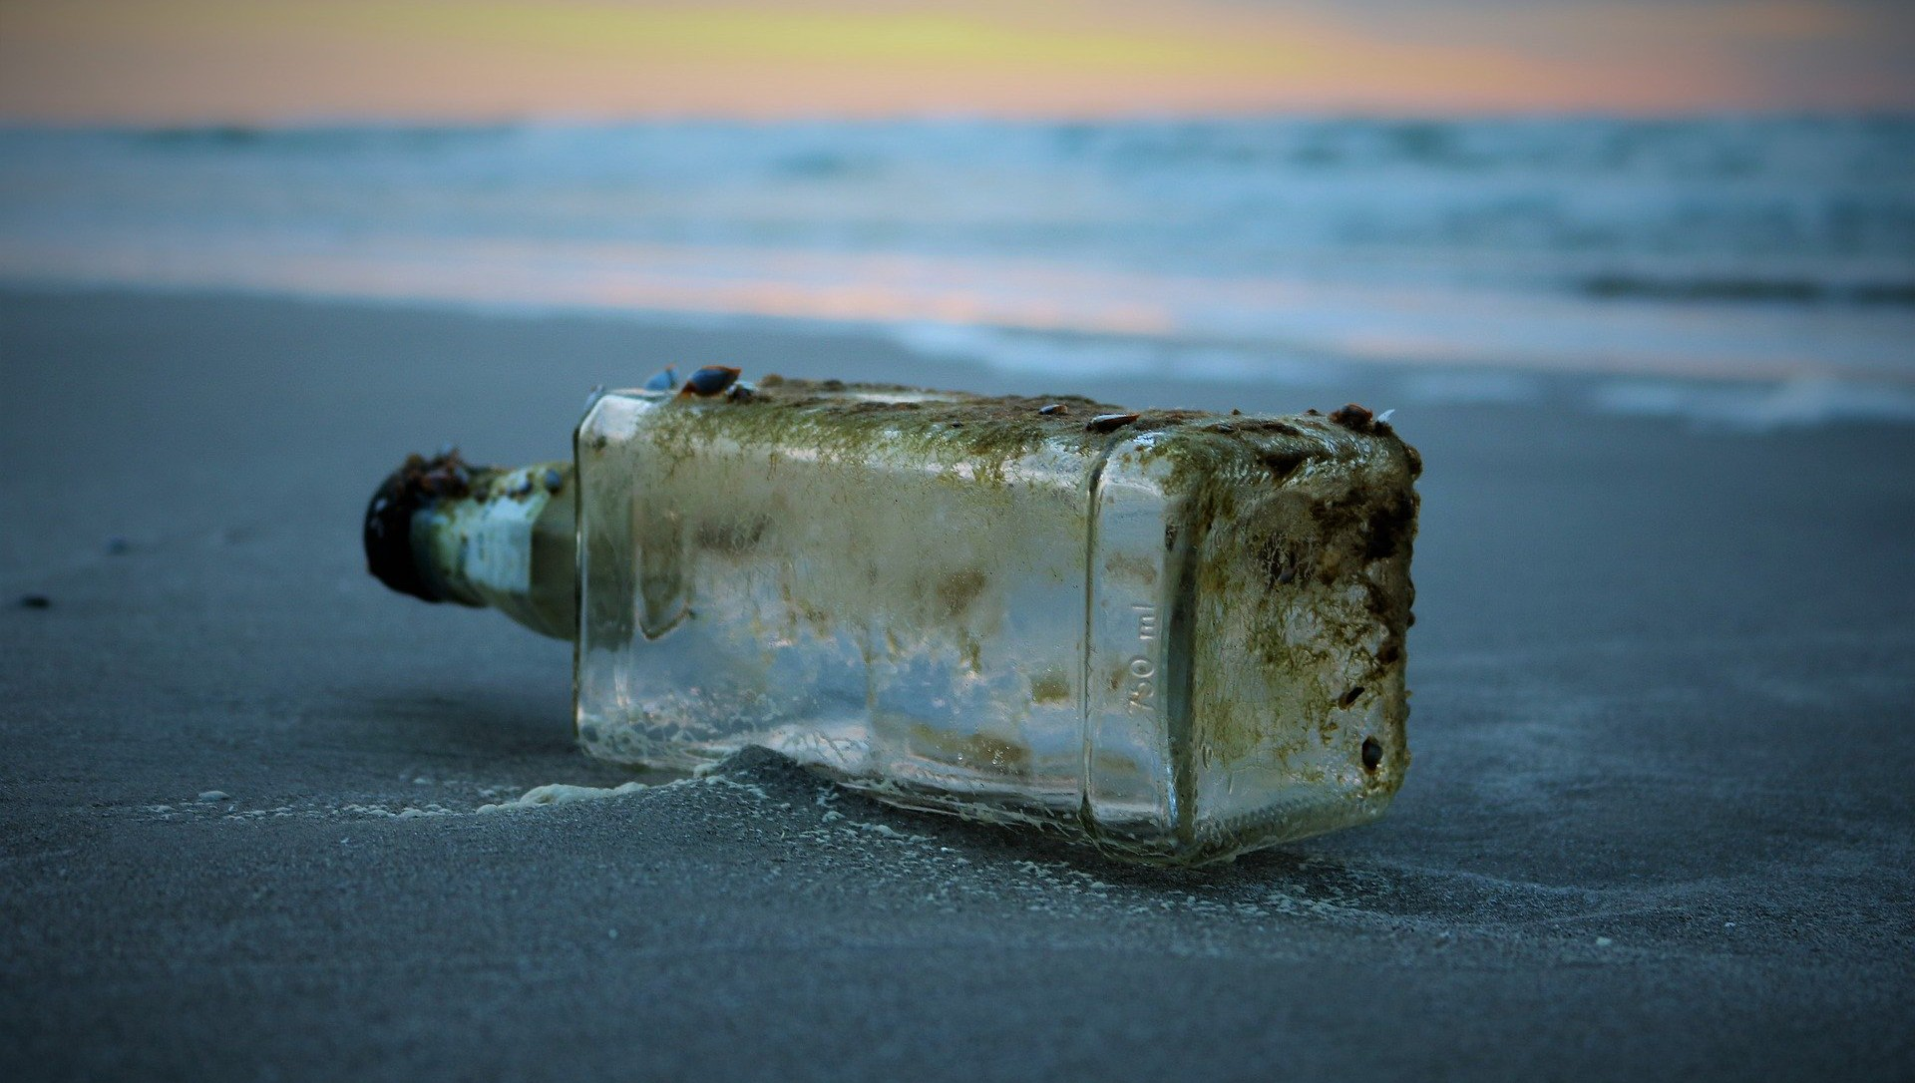
United Nations Environment Programme Cartagena Convention Secretariat
Protecting Our Caribbean Sea. Sustaining Our Future
Sustaining Our Future
THANK YOU/GRACIAS/MERCI
United Nations Environment Programme Caribbean Environment Programme and Cartagena Convention Secretariat
14-20 Port Royal Street Kingston, Jamaica, W.I.
https://www.unenvironment.org/cep/
unep-cartagenaconvention@un.org
https://www.ima.gov.tt/ http://www.cimab.transnet.cu/ http://www.racrempeitc.org/
UNEPCartagenaConvention
UNEP_CEP
Youtube: CEPUNEP
LinkedIn: UNEP-Caribbean Environment Programme

